Slide 1

DATA ENGINEER
ASSESSMENT
Name: Jefferson Matos Oliveira
Position: Data Engineer Manager

Slide 2















SOLUTION ARCHITECTURE
Source
Capture
Ingest
Processing
Store
Serve
1
Application
2
3
4
5
Files
GKE
Pub/Sub
Dataflow
BigQuery
Data Studio
Orchestration
Airflow On GKE
DataOps
Security and Governance
Monitoring and Logging
6
7
8
Cloud Build
Container Registry
KMS
IAM
Data Catalog
DLP
Cloud Monitoring
Cloud Storage

Slide 3
ARCHITECTURE DESCRIPTION
1
Use a GKE service to deploy an Apache Airflow platform to orchestrate na containerezed app (Docker) on GKE cluster, that will collect files from the repository and convert to a stream and publish to a Topic on a Pub/Sub service.
5
Google Data Studio or any other DataViz tool supported by Big Query to allow BI users to build their dashboards that could address the main questions about the flights information.
2
Use a Pub/Sub service to configure the Topics that are necessary to ingest the data from the files.
6
Use serverless services to allow the CI/CD pipelines in a automation perspective to deploy the applications and integrate the supported services.
3
Use a Dataflow service to build a streaming application that subscribe to a Pub/Sub topic, collect the data and prepare the data using cleanse, data quality and transformation techiniques. Using a Big Query service as the sink endpoint.
7
Services as Data Catalog ensure that the users could know the data available on Big Query to ask for access and use the IAM service to ensure the data access and KMS to managed the keys for applications and data security. DLP should be available to keep the data safe from exfiltration.
4
The BigQuery service should be used as the storage and analytical layer to leverage to the users a way to query the data, modeling and build ad-hoc analysis as well as use ML models.
8
Enable Cloud Monitoring to collect logs and metrics that allow the infrastructure and application teams to monitor the solution allow observability across the data resources and SRE for business improvement.

Slide 4
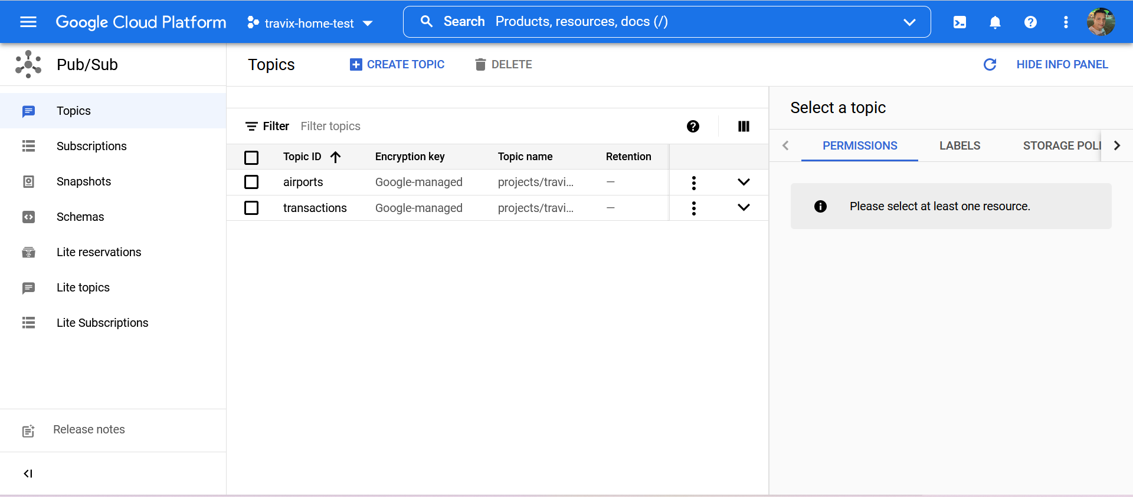
GCP COMPONENTS – PUB/SUB

Slide 5
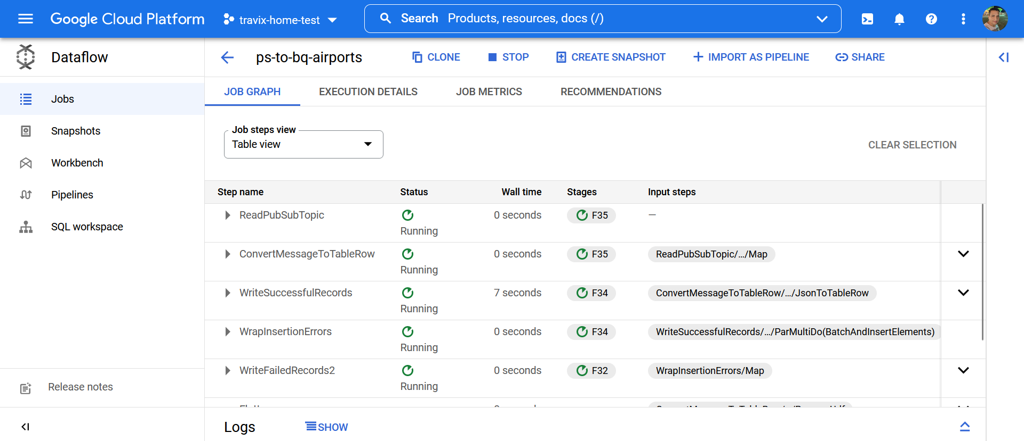
GCP COMPONENTS – DATAFLOW

Slide 6
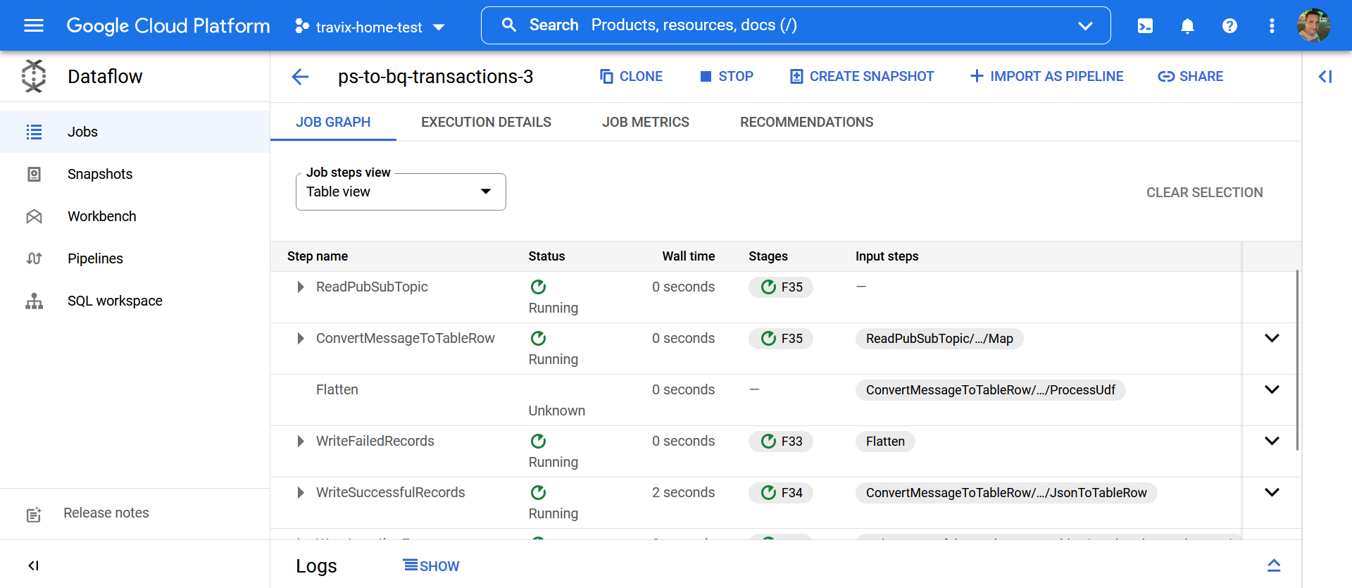
GCP COMPONENTS – DATAFLOW

Slide 7
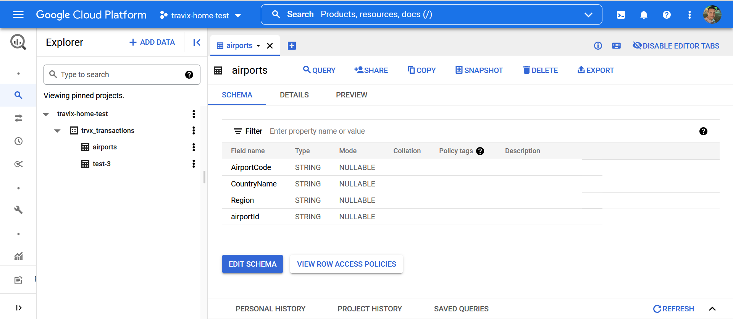
GCP COMPONENTS – BIGQUERY

Slide 8
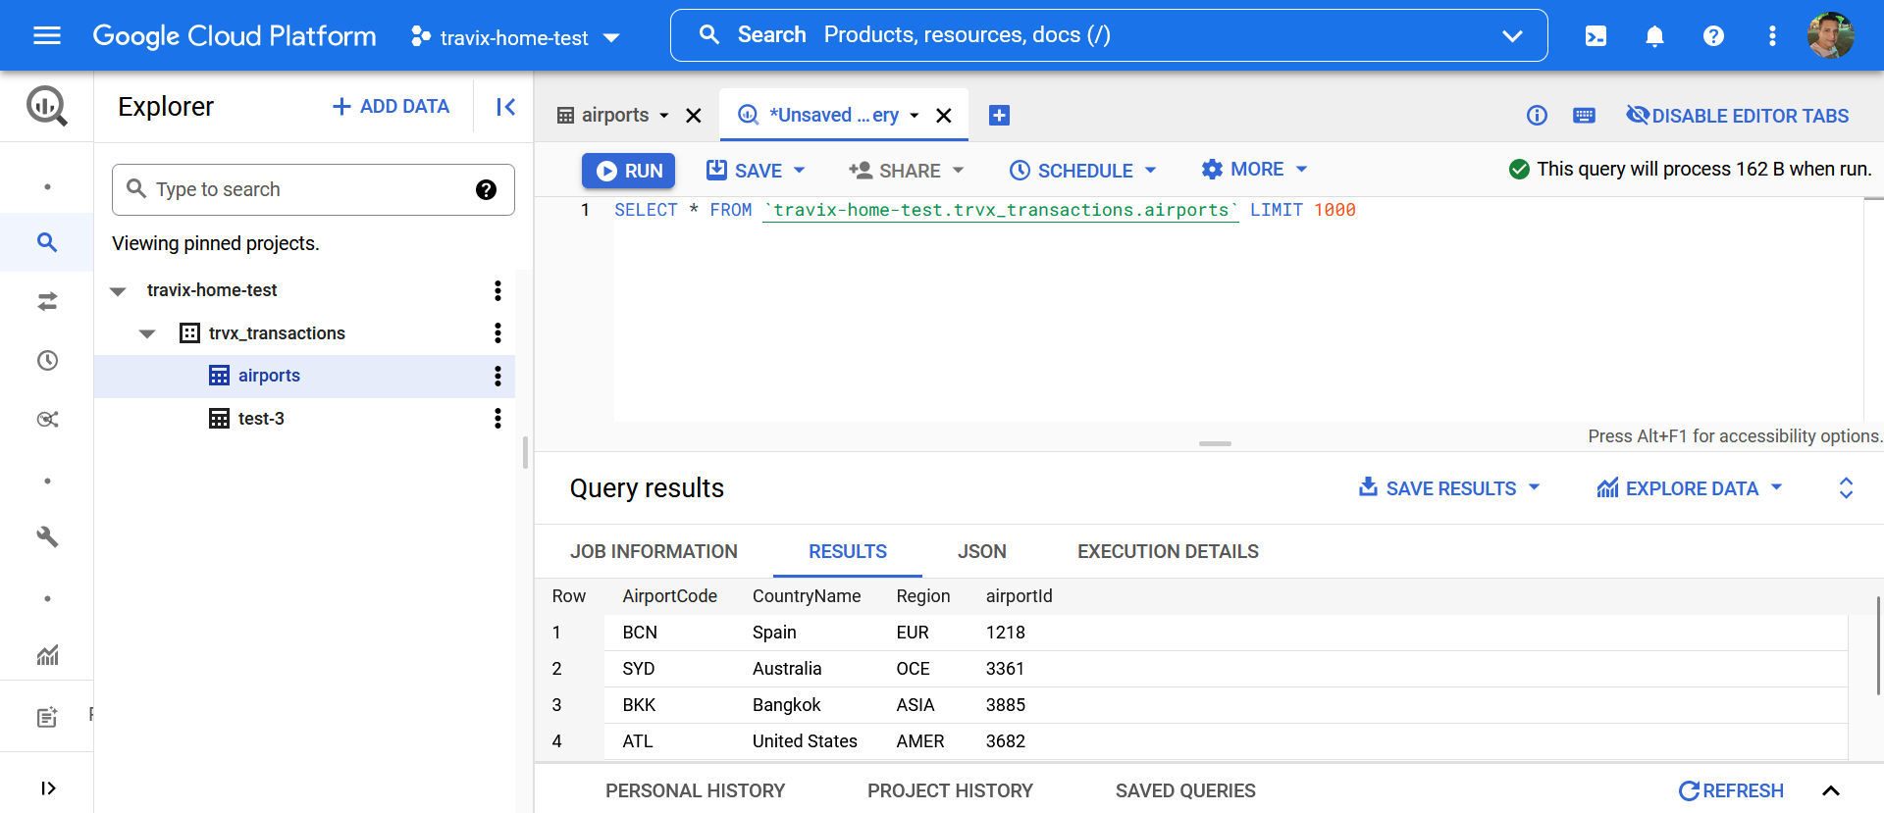
GCP COMPONENTS – BIGQUERY

Slide 9
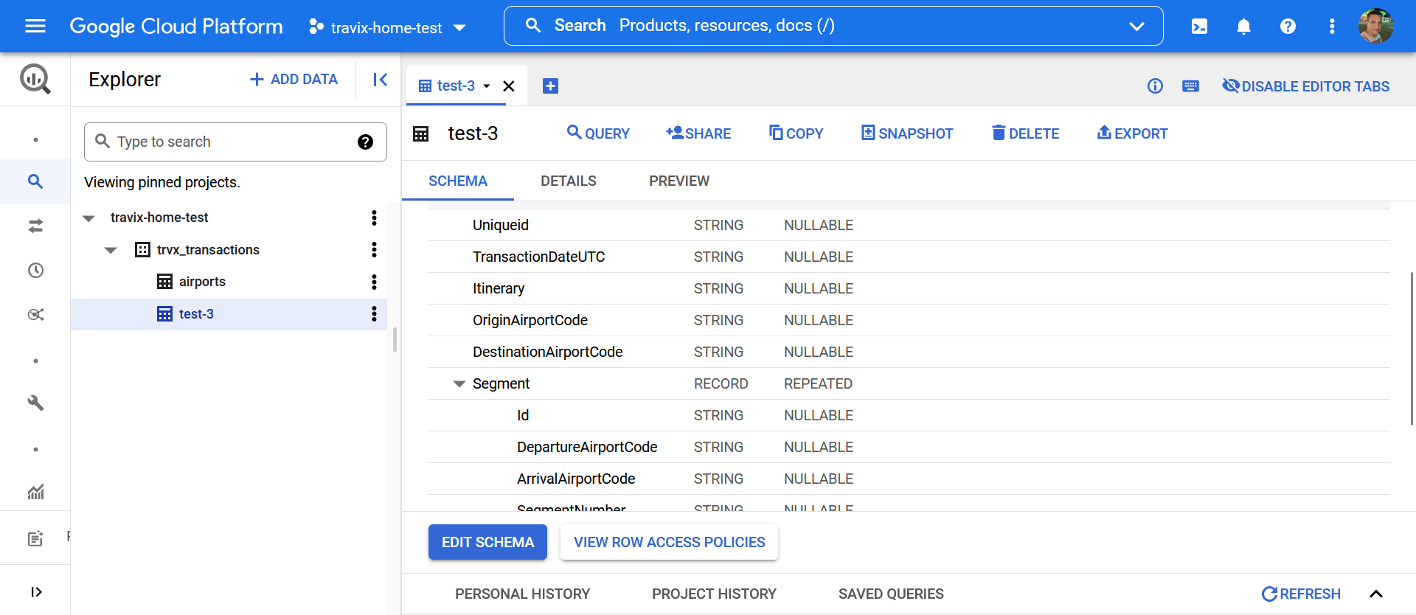
GCP COMPONENTS – BIGQUERY

Slide 10
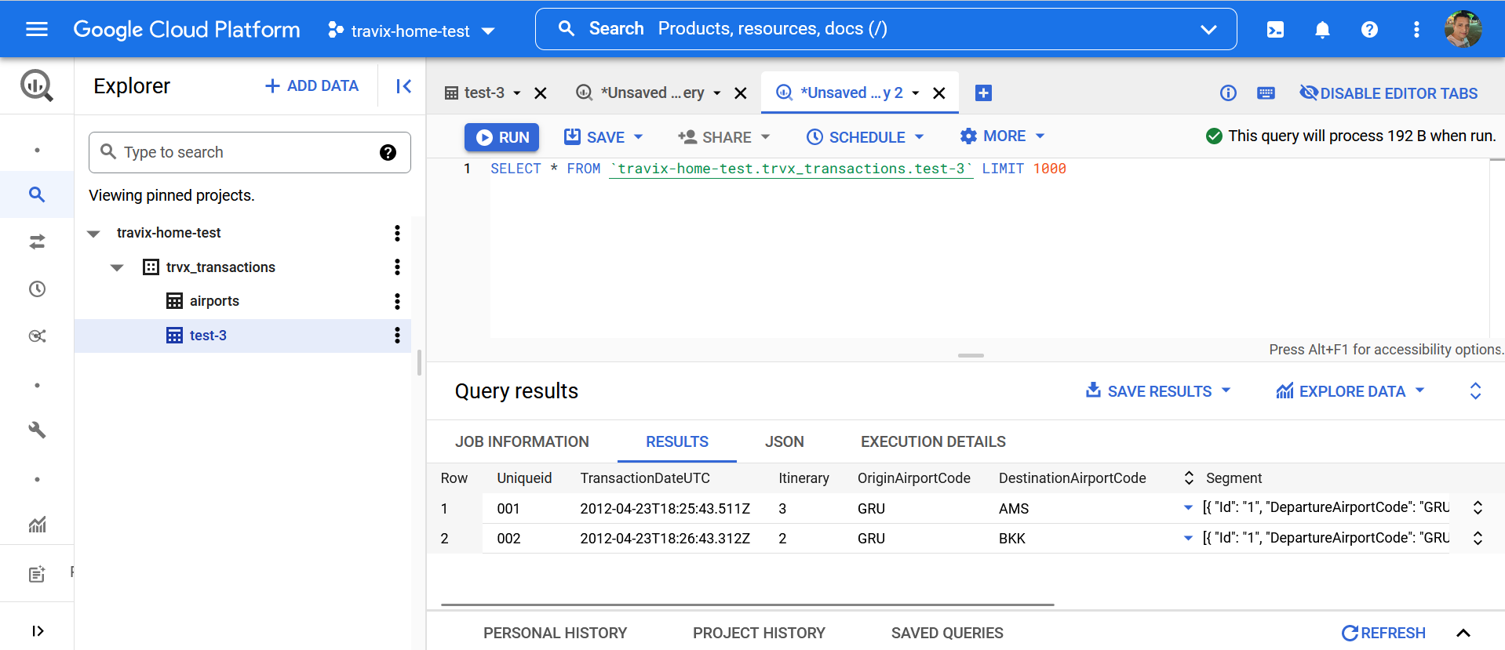
GCP COMPONENTS – BIGQUERY

Slide 11
TEST - SOLUTION CONSIDERATIONS
Phase 1
At this step, I consider developing a python script that could receive parameters related to the files to be parsed and ingested as well as the name or prefix of the file, file type, path of the file location and some flags that indicate if should execute before to another sequenced file.
The python script should be executed via the Airflow operator as a container on the GKE infrastructure. The main objective of this python script is to read a JSON file and send each data structure on a Pub/Sub topic.
Phase 2
For phase 2 I should consider developing a job on Dataflow that reads data from a Pub/Sub and write it to a Big Query table using a Flex Template and orchestrated via Airflow, deploying a docker image that instantiates the job via command line. On BigQuery is truly important to define the partition column at the tables.
Phase 3
From which Country are most transactions originating? How many transactions is this?
SELECT SUM (QtdTransact) As TotalTransact, COUNT (*) AS QtdTransact, L.CountryName
FROM locations as L, transactions as T
WHERE T.OriginAirportCode = L.AirportCode
GROUP BY CountryName
ORDER BY TotalTransact
What's the split between domestic vs international transactions?
Complimentary metadata is needed to achieve this insight since is not clear wether the Region column in the locations table is related to another Country/Continent or a State/Province and from which country we are considering as the domestic one.
What's the distribution of number of segments included in transactions?
transactions = sns.load_dataset(“transactions")
sns.displot(transactions, x=“SegmentNumber")

